Slide 1
Ch 6 Folding (Gấp lại)
ĐHBK Tp HCM
BMĐT
GV: Hồ Trung Mỹ
TLTK:
Các slide từ sách của Prof. Parhi
Slide của Prof. Viktor Öwall
Slide của Prof. Lan-Da Van

Slide 2
Outline
6.1 Introduction
6.2 Folding Transformation
6.3 Register Minimization Techniques
6.4 Register Minimization in Folded Architecture
6.5 Conclusions

Slide 3
6.1 Introduction
Systematically determine the control circuits in DSP architectures by folding transformation, where multiple algorithm operations are time-multiplexed to a single functional unit.
Use for synthesis of DSP architectures that can be operated at single or multiple clocks.
Use to reduce the number of hardware functional units (FUs) by a factor of N at the expense of increasing computation time by a factor of N.
Lead to an architecture that uses a large number of registers and thus present the register minimization technique.

Slide 4
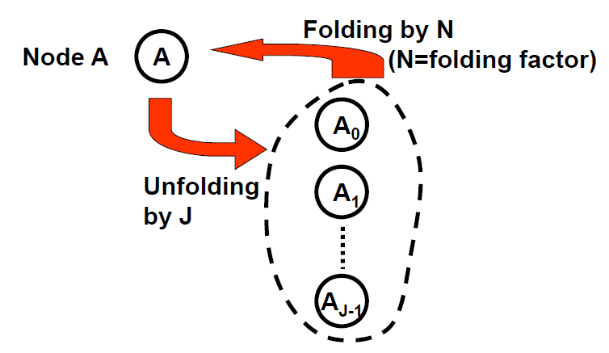
Folding is ”Inverse” of Unfolding

Slide 5
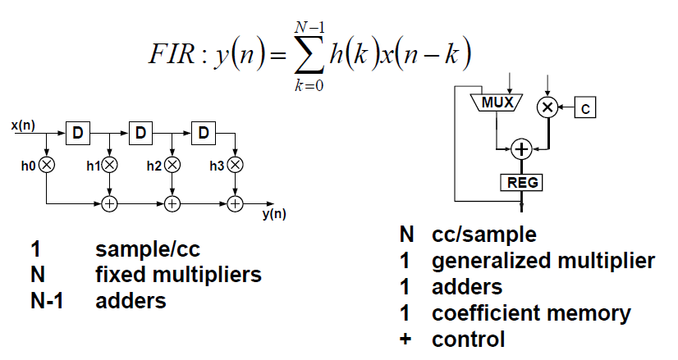
Hardware Mapped vs. Time multiplexed

Slide 6
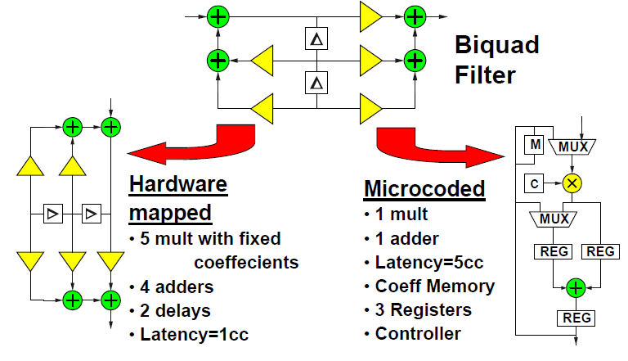
Hardware Mapped vs. Time multiplexed/Microcoded

Slide 7
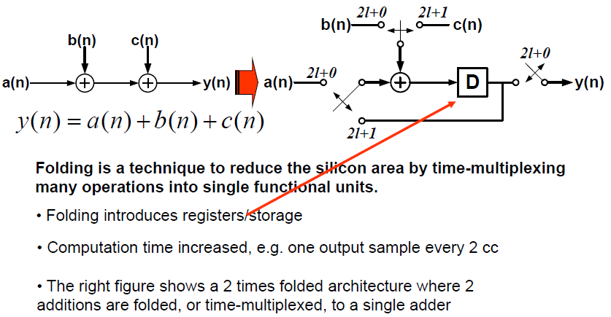
Folding – Time-shared Architecture

Slide 8
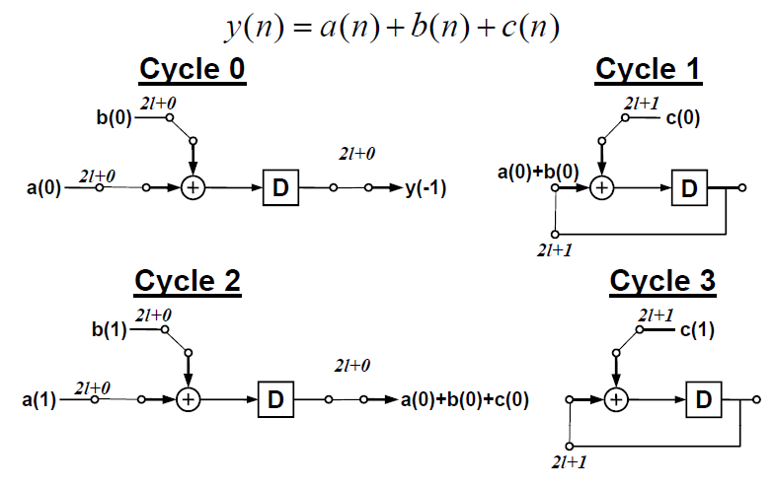
Folding, example

Slide 9
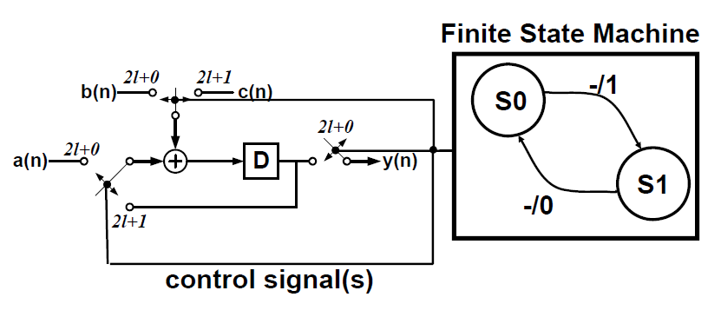
Control Unit

Slide 10
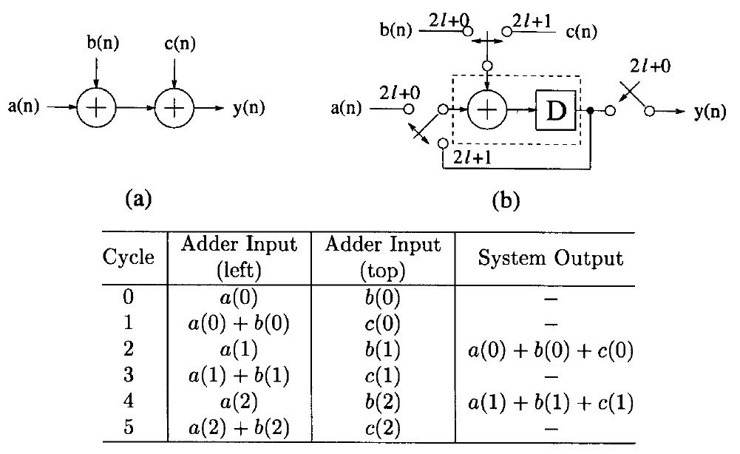
Folding, example

Slide 11
Folding
Reduce hardware by N-folding
T_{computation} increased by N ⇒ Latency
Extremes
Fully parallel
Time multiplexed = 1 unit per algorithmic operation
Folding ⇒
extra registers, i.e. extra storage
control unit
latency

Slide 12
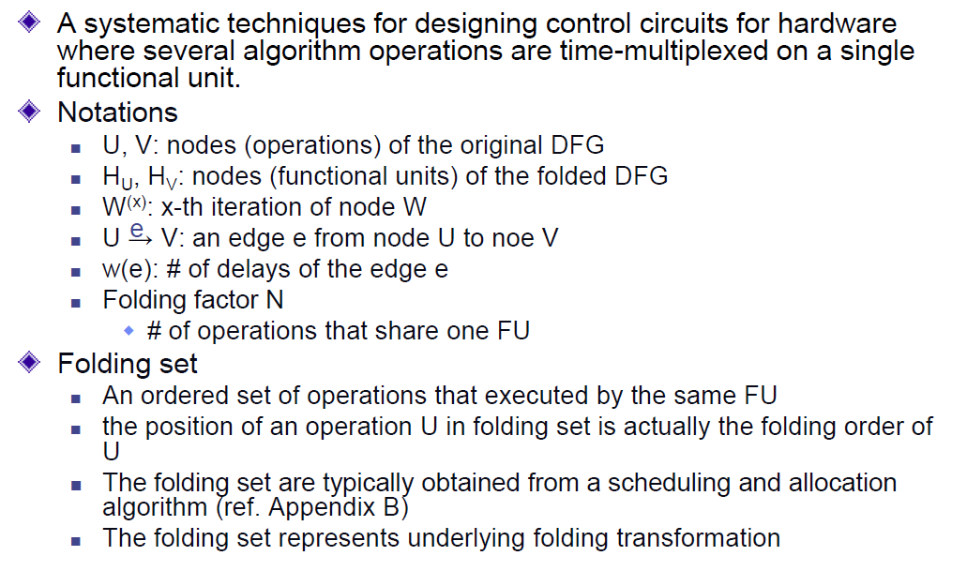
6.2 Folding Transformation
(FU)

Slide 13
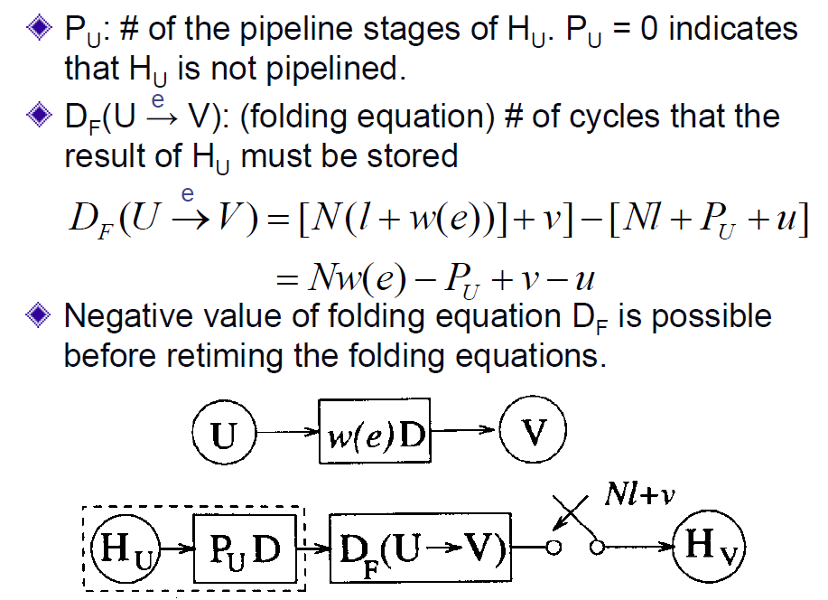
Folding Transformation (cont’d)

Slide 14
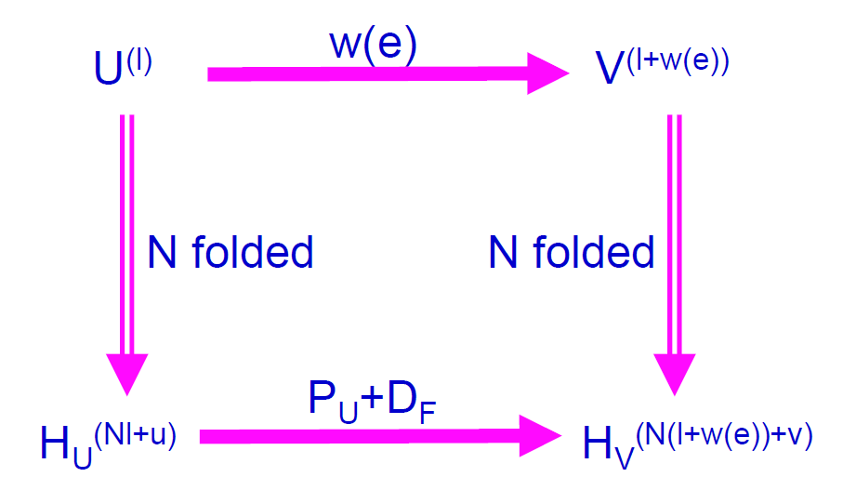
Folding Transformation (cont’d)

Slide 15
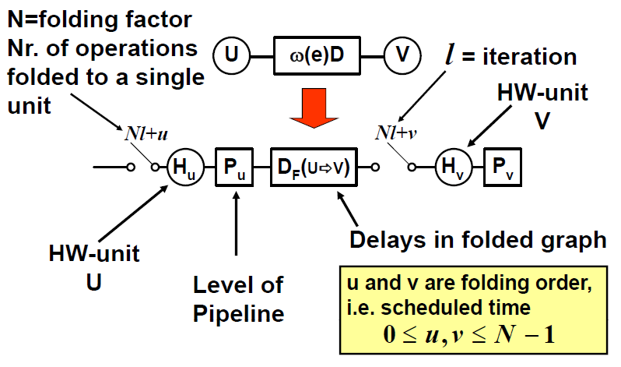
Folding Transformation (cont’d)

Slide 16
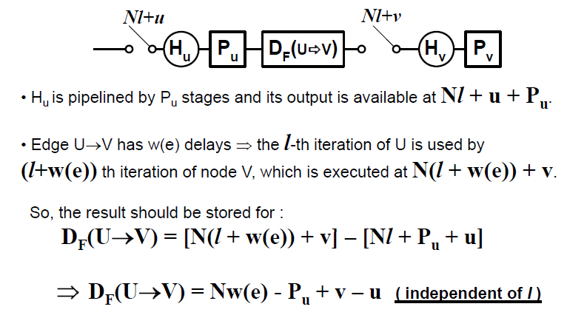
Folding Transformation (cont’d)

Slide 17
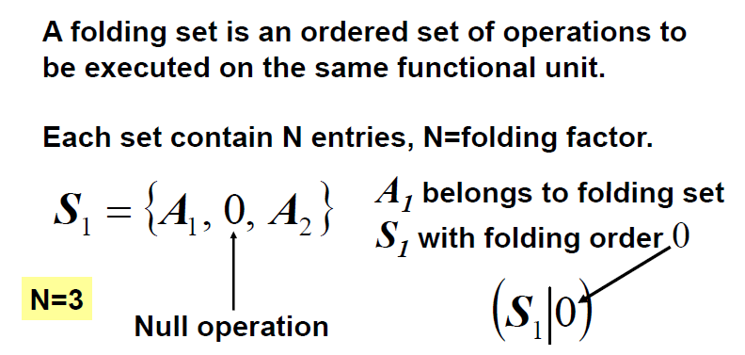
Folding Set
The operation A₂ belongs to the folding set S₁ has a folding order of 2 are denoted by (S₁|2).

Slide 18
Three concepts
Allocation - determine architectural resources
Assignment - binding operations to hardware
Scheduling - determine execution order

Slide 19
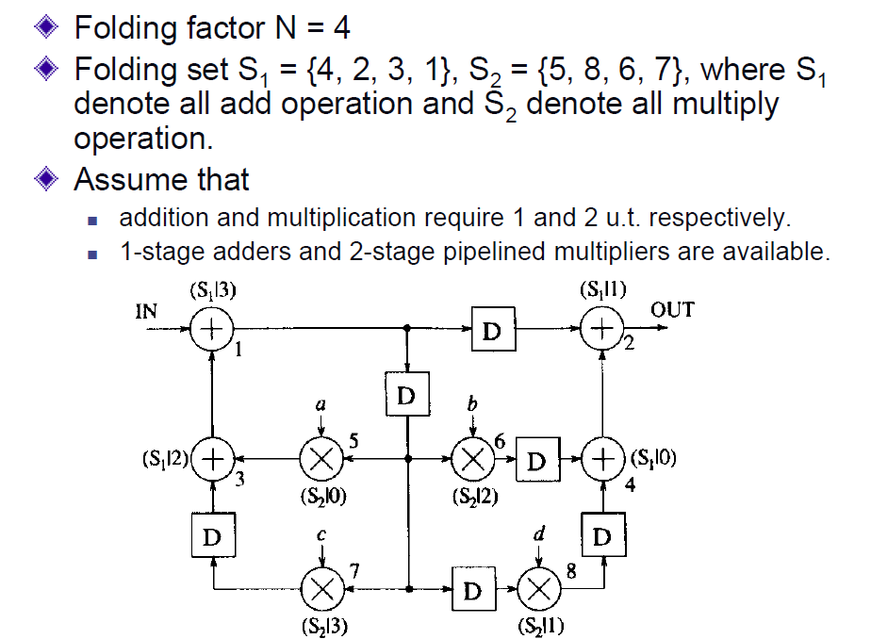
Folding Retimed Biquad Filter

Slide 20
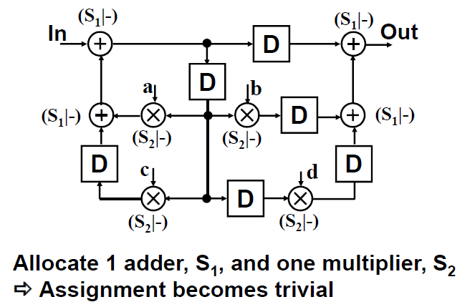
Allocation and Assignment

Slide 21
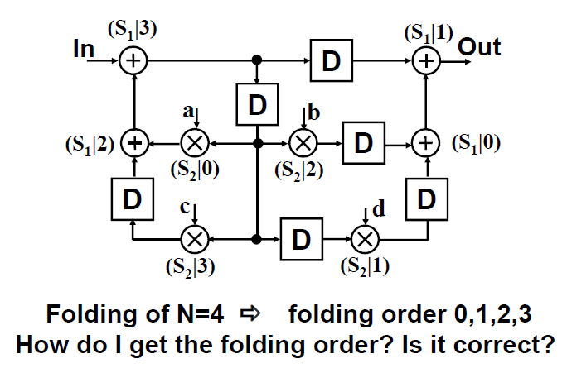
Scheduling

Slide 22
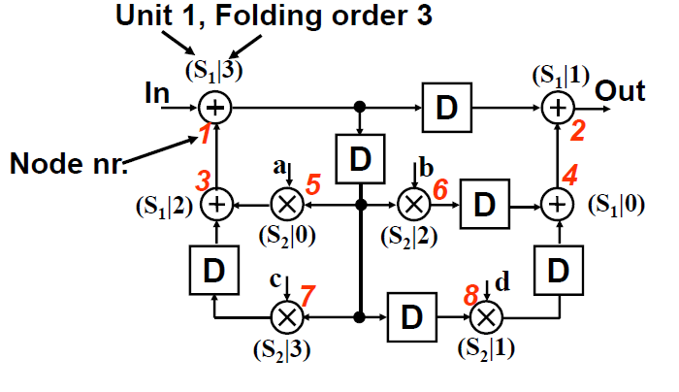
Folding of Biquad filter

Slide 23
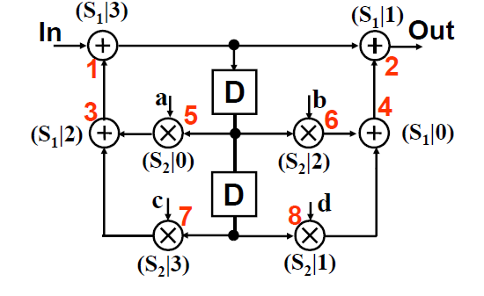
So why didn’t the filter look like this?

Slide 24
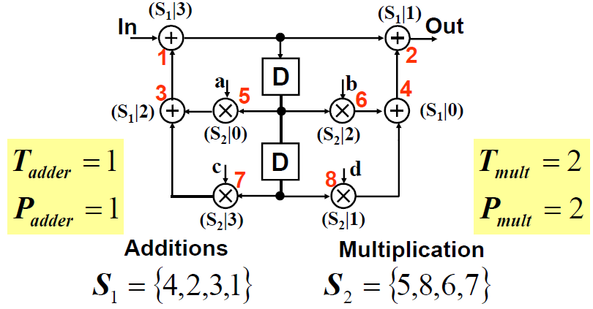
So why didn’t the filter look like this?

Slide 25
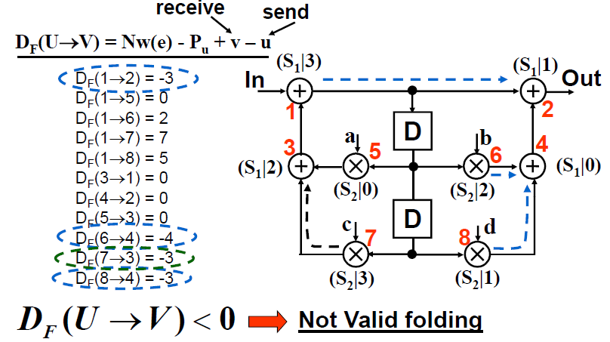
Folding of Biquad filter, N=4
Note: u and v are folding orders of U and V respectively.

Slide 26
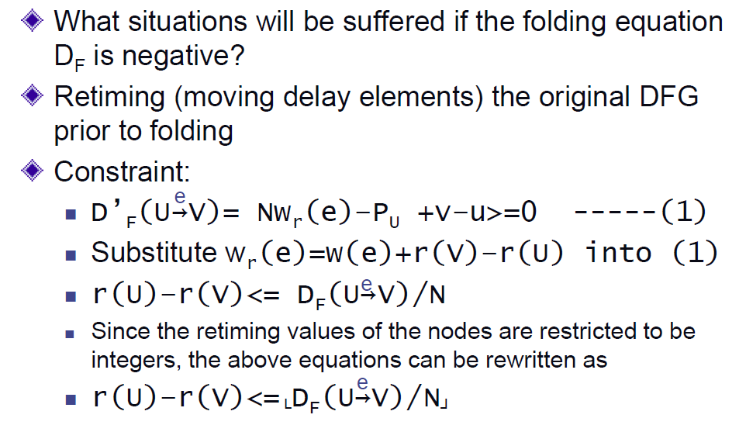
Retiming

Slide 27
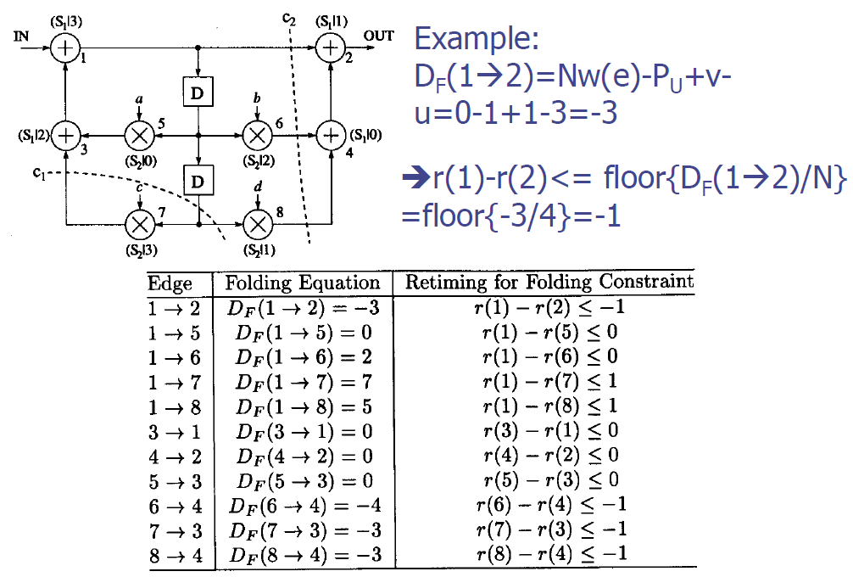
Retiming

Slide 28
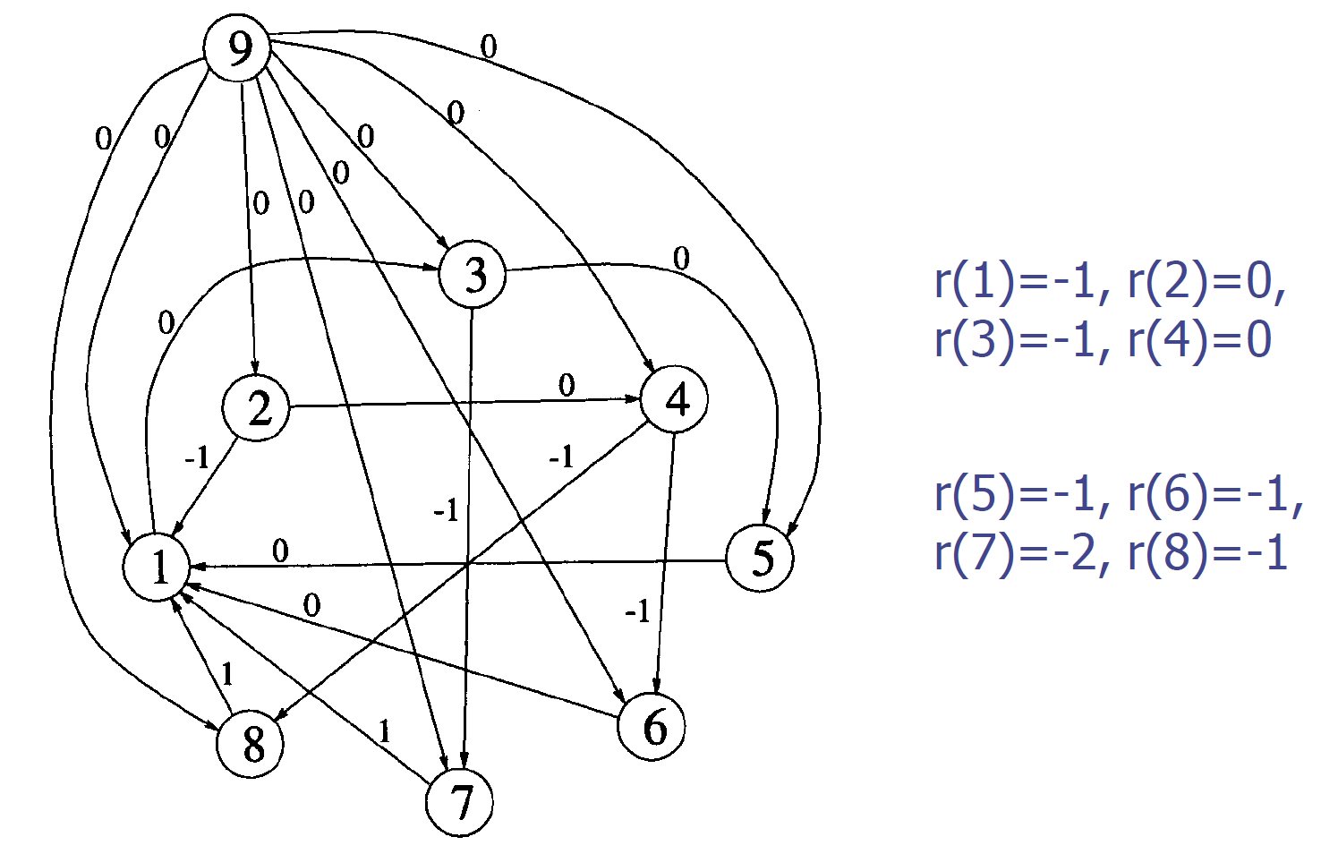
Retiming

Slide 29
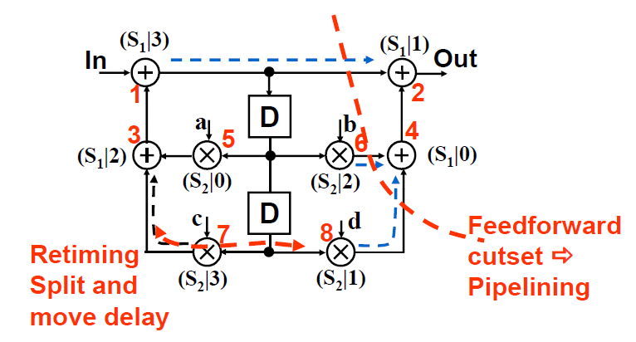
Folding of Biquad filter, N=4

Slide 30
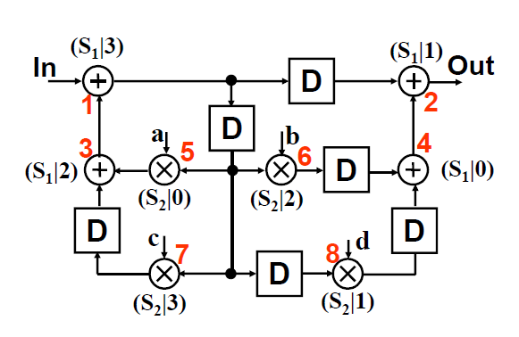
Folding of Biquad filter

Slide 31
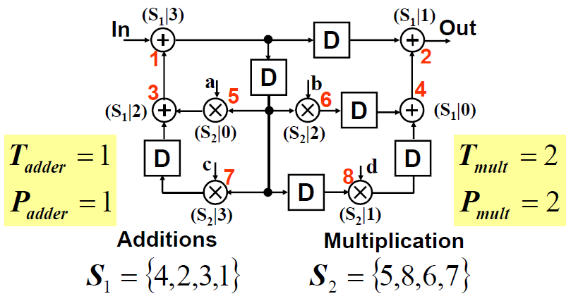
Folding of Biquad filter, N=4

Slide 32
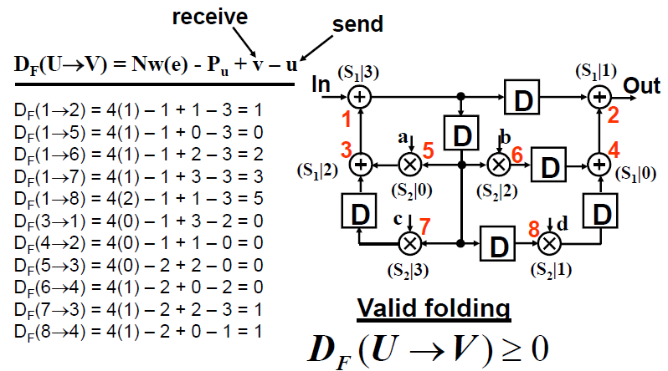
Folding of Biquad filter, N=4

Slide 33
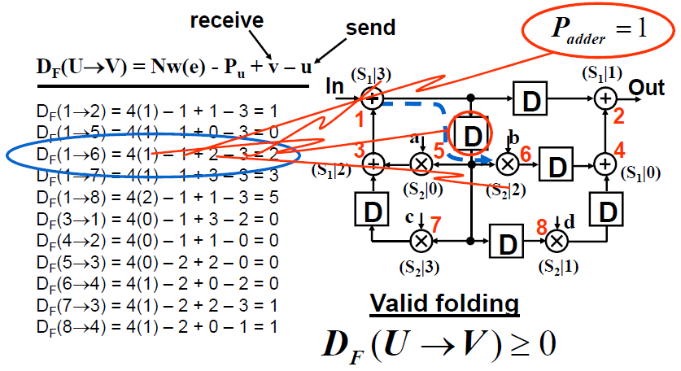
Folding of Biquad filter, N=4

Slide 34
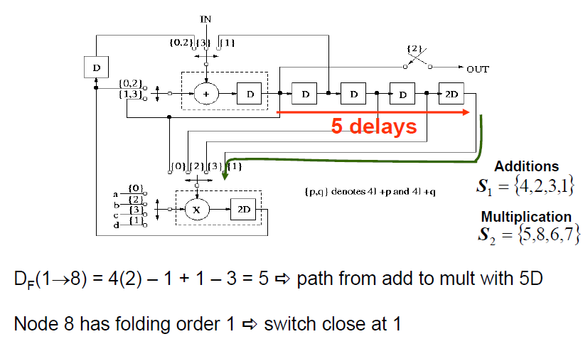
Folding of Biquad filter, N=4

Slide 35
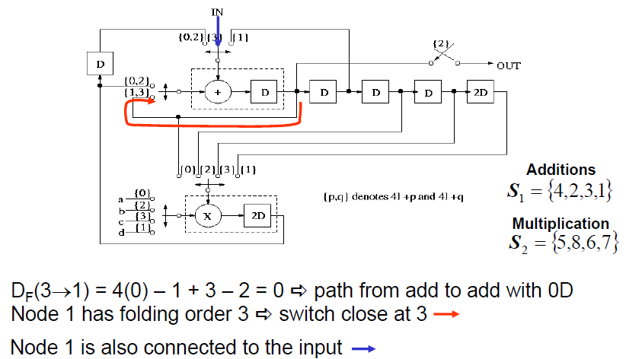
Folding of Biquad filter, N=4

Slide 36
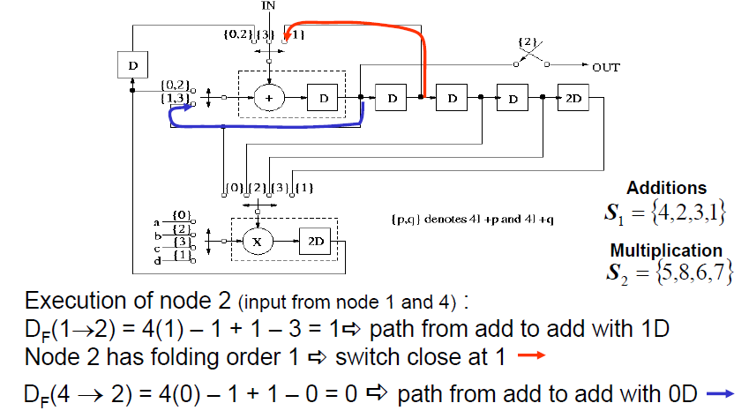
Folding of Biquad filter

Slide 37
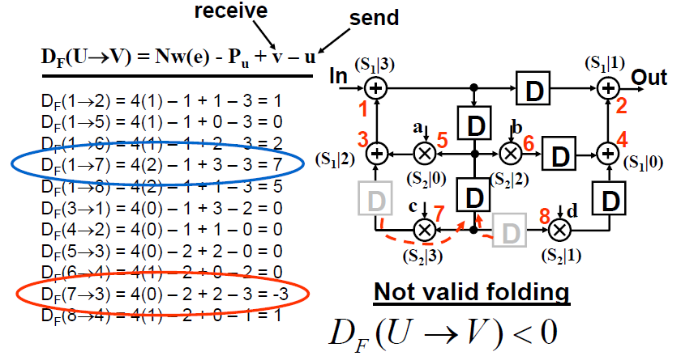
Folding of Biquad filter, N=4

Slide 38
Hardware Mapped vs.Microcoded

Slide 39
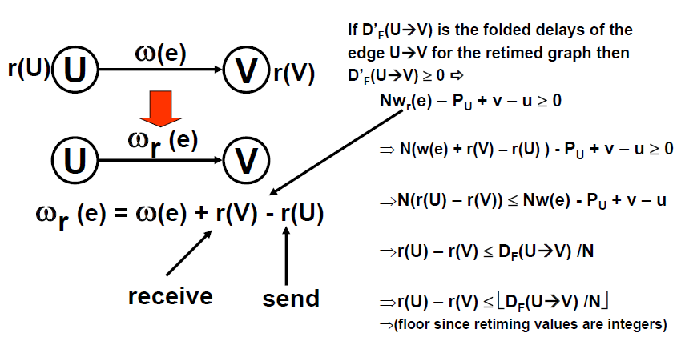
Retiming for Folding

Slide 40
6.3 Register Minimization Techniques
Folding may insert registers.
Lifetime analysis is used for register minimization techniques
A procedure used to compute the minimum number of registers required to implement a DSP algorithm in hardware.
A variable is live from the time it is produced until the time it is consumed. After then, it is dead.
The number of live variables at each time unit is computed, and the maximum number of live variables at any time unit is determined
Forward-backward register allocation technique.
Linear lifetimes analysis and Circular lifetime analysis

Slide 41
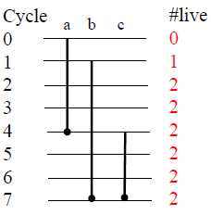
Linear Lifetime Analysis
Linear lifetime chart: represents the lifetime of the variables in a linear fashion.
Max. number of live variables in linear lifetime chart ⇒ Min. number of registers in implementation
Convention:
A variable is live from the time it is produced until the time it is consumed. After then, it is dead.
A variable is
not live during the clock cycle when it is produced
but live during the clock cycle when it is consumed.

Slide 42
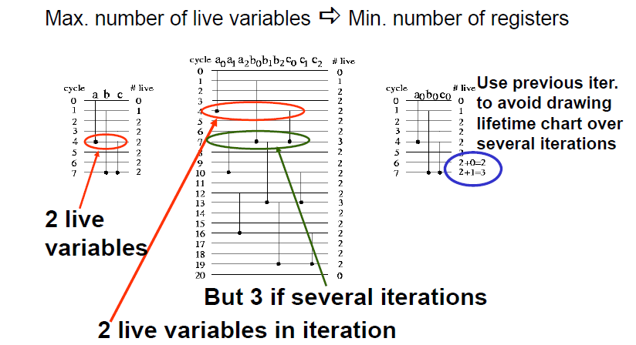
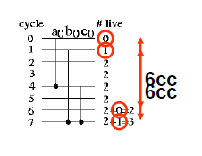
Register Minimization

Slide 43
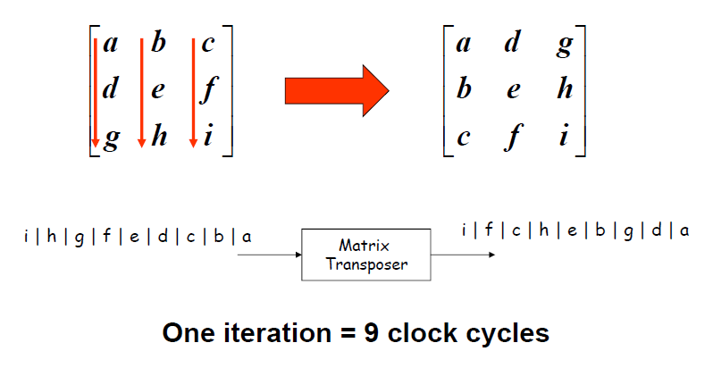
3x3 Matrix Transpose

Slide 44
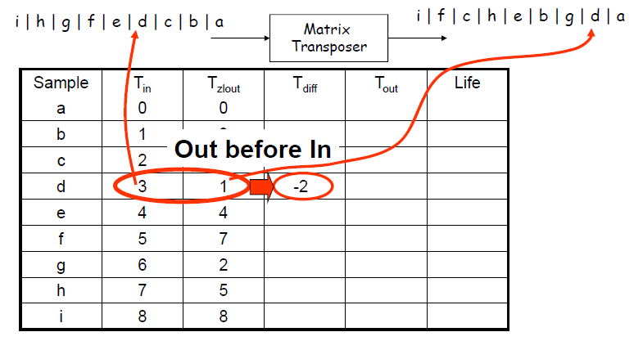
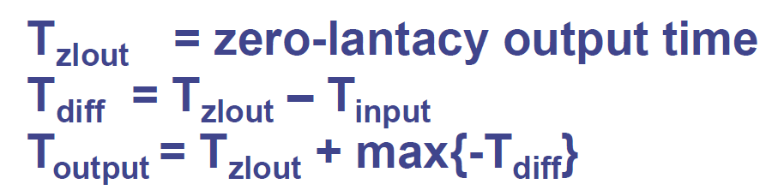
Lifetime Table - 3x3 Matrix Transpose

Slide 45
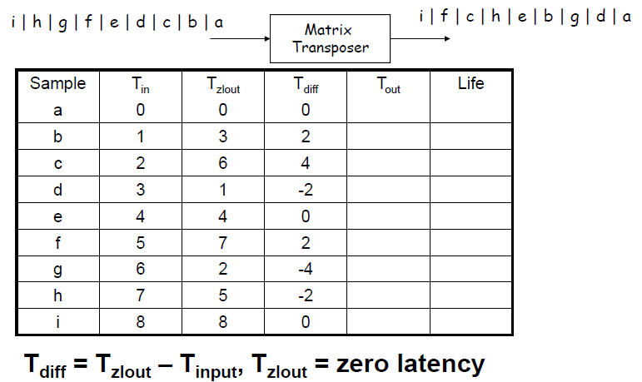
Lifetime Table - 3x3 Matrix Transpose

Slide 46
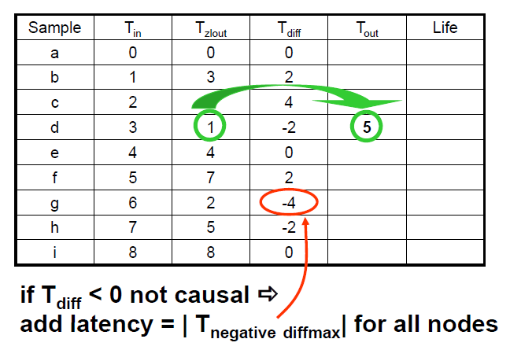
3x3 Matrix Transpose

Slide 47
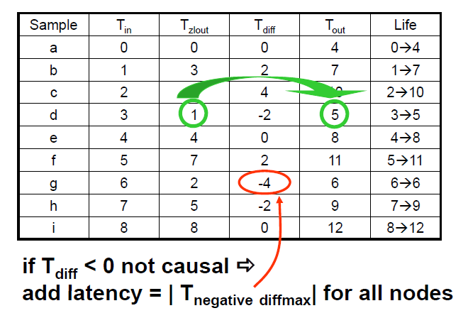
3x3 Matrix Transpose

Slide 48
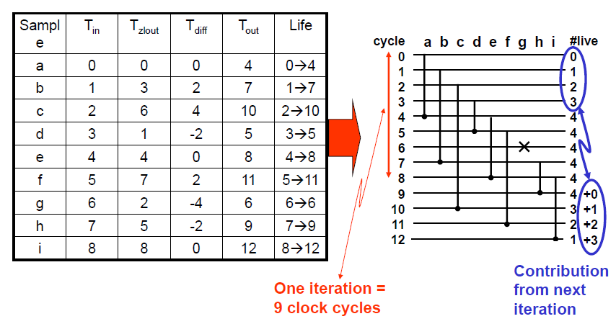
Lifetime chart 3x3 Matrix Transpose

Slide 49
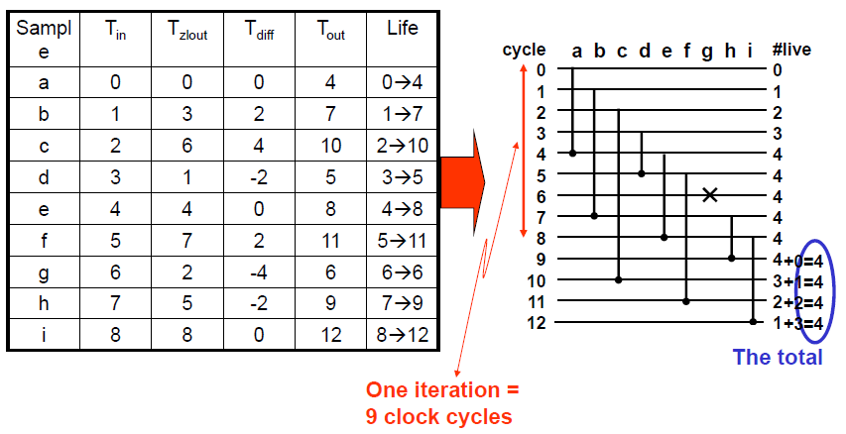
Lifetime chart 3x3 Matrix Transpose

Slide 50
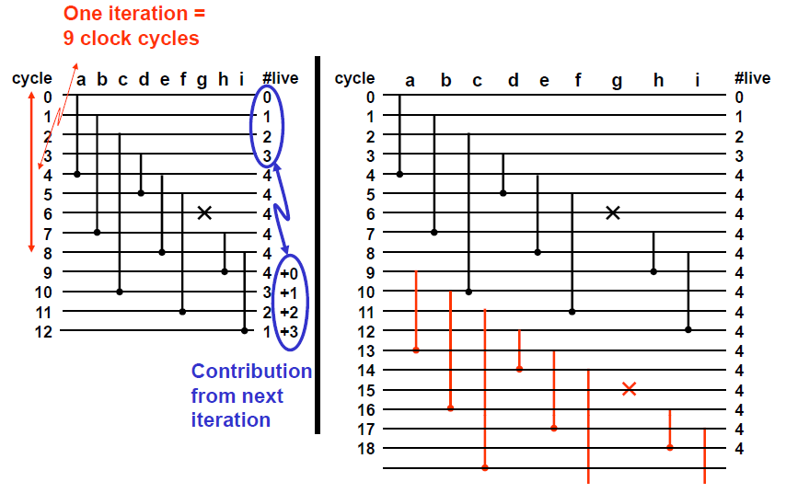
Lifetime chart

Slide 51
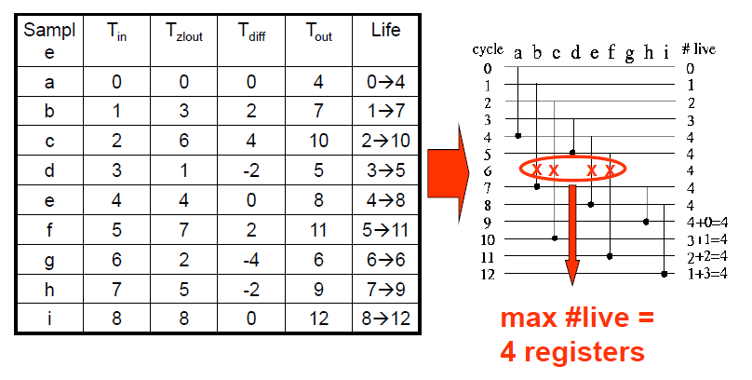
Lifetime chart 3x3 Matrix Transpose

Slide 52
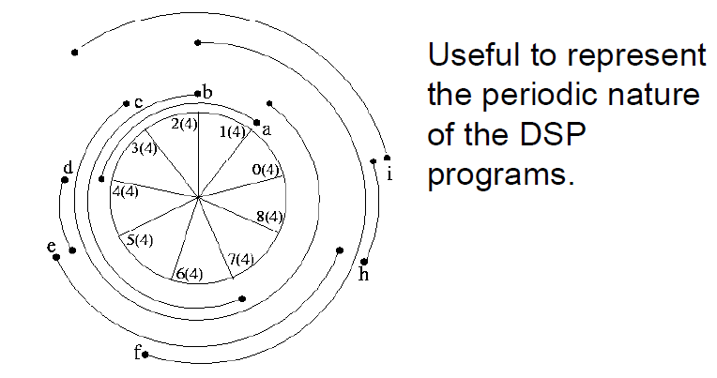
Circular lifetime chart
In a circular lifetime chart of periodicity N (= 9), the point marked i (0 ≤ i ≤ N -1) represents the time partition i and all time instances {(Nl+i)} where l is any non-negative integer.
For example : If N = 9, then time partition i = 3 represents time instances {3,12, 21,}.
Notice that variable produced during time unit j and consumed during time unit k is shown to be alive from ‘j +1’to ‘k’.
The numbers in the parentheses in the adjacent figure correspondto the # of live variables at each time partition.

Slide 53
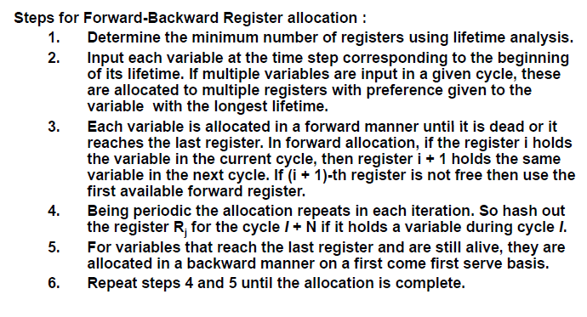
Forward Backward Register Allocation Technique

Slide 54
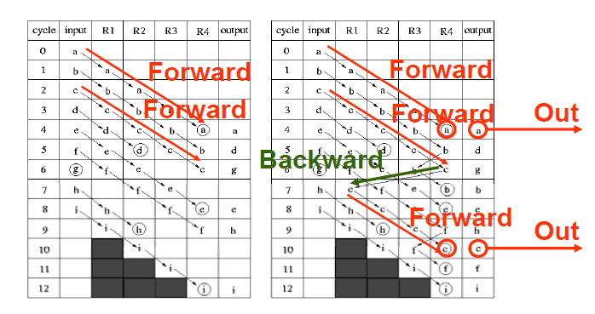
Forward Backward Register Allocation Technique (2/2)

Slide 55
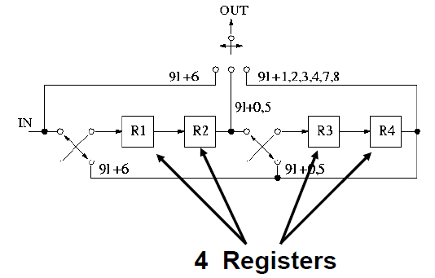
Folded Architecture for Matrix Transposer

Slide 56

Controller for Folded Architecture

Slide 57

First-In-First-Out, FIFO

Slide 58

FIFO (2/3)

Slide 59

FIFO (3/3)

Slide 60

FIFO with pointers

Slide 61

Lifetime chart 3x3 Matrix Transpose

Slide 62
6.4 Register Minimization in Folded Architecture
Steps:
Perform retiming for folding
Write the folding equations
Use the folding equations to construct a lifetime table
Draw the lifetime chart and determine the required number of registers
Perform forward-backward register allocation
Draw the folded architecture that uses the minimum number of registers.

Slide 63

Biquad Filter Example

Slide 64


Biquad Filter Example (2/4)

Slide 65

Register Minimization of Biquad filter

Slide 66

Biquad Filter Example (3/4)
n₁, n₇, and n₈ have nonzero duration
n_{i} denotes the output of the node i
Note:
Also, the table shows that the variable n1 is output in cycle 9. Note that this variable is also output in cycles 4, 5, 6, and 8. For the sake of clarity, the table only shows the latest output time of each variable.

Slide 67

Lifetime chart of Biquad filter...

Slide 68

...and Register Allocation

Slide 69


Biquad Filter Example (4/4)
Fig. 6.16 A folded biquad filter architecture implementing the DFG in Fig. 6.3 using the minimum number of registers, which is 2.

Slide 70

Previous architecture

Slide 71

Biquad Filter

Slide 72

BiquadFilter?

Slide 73
Which approach to use?
Depends on:
number of positions
number of moves
complexity of address calculation
etc...
As the number of positions increase a memory solution becomes more favorable.
Decide on case by case basis.

Slide 74


IIR Filter Example

Slide 75

IIR Filter Example (2/4)

Slide 76

IIR Filter Example (3/4)

Slide 77


IIR Filter Example (4/4)

Slide 78
6.5 Conclusions
Present a systematic transformation of time-multiplexed architectures
Explore folding techniques to reduce # of functional units
Explore register minimization technique to reduce # of registers

